Slide 1
Of Mice and Men
_________________
_______________

Slide 2
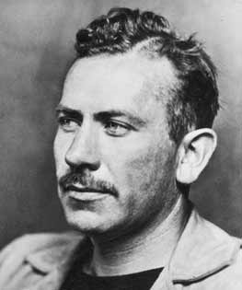
John Steinbeck
Born in ________________
Lived 1902-1968
He spent his summers working on ranches near his home
Notes:
He wrote from experience – not necessarily the experience of a migrant worker, but something akin to that from his childhood.

Slide 3
The Book
A ___________is longer than a short story, shorter than a novel
Won the Pulitzer Prize in 1937
It is a banned book
Vulgar language
Profanity, racial slurs, blasphemy
Anti-business
Unpatriotic
Violence
“does not represent traditional values”

Slide 4
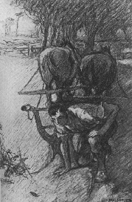
The Title:
“The best laid plans
of mice and men
often go awry.”
-Robert Burns
What does this mean??

Slide 5
Style of Novel
Steinbeck set out to create a new literary form
Some call the book a “play-novelette”
He developed the characters through ___________ and ________ rather than letting the reader in on their thoughts
He starts each scene with a description of the , much like a play is staged around its sets
The action in each chapter follows the pattern of drama
Dialogue is used to reveal characters

Slide 6
Language of the Novel
Steinbeck’s language in his descriptions of nature is full of and
Since the story is about laborers, it is appropriate that their dialogue is unrefined and realistic
Slang, profanity, and uneducated pronunciation
The coarseness of the language contrasts with the tender motives of the main characters

Slide 7
Point of View
Story is told through point of view
Reader is not directly let in on the thoughts of the character or their feelings about themselves and others
Reader must draw his/her own conclusions
Helps reader feel the information presented is in a straightforward manner and that no information has been left out

Slide 8
Setting
_____________ and __________________determine the mood and help the unfolding of the plot
The time is during the Depression years, when people had little but the clothes on their backs
Many were homeless and wandered the countryside picking up odd jobs

Slide 9
Setting
The place is a near Salinas River in California.
His descriptions of the riverbank and barn scenes contrast with the bunkhouse setting
The natural scenes evoke a sense of beauty and openness
The indoor scenes evoke starkness and imprisonment

Slide 10
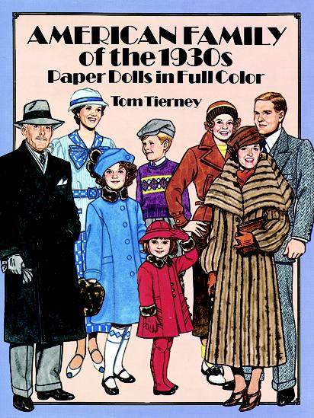
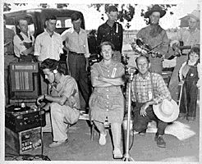
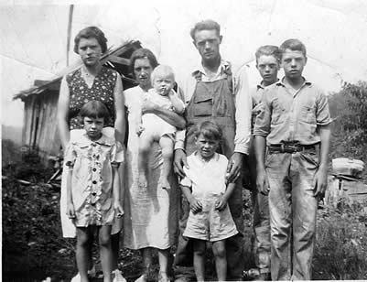
Setting – 1930s
_______________________
Severe economic crisis supposedly precipitated by the US stock-market crash of 1929
Average salary $1,368
Bread cost 9¢ a loaf

Slide 11
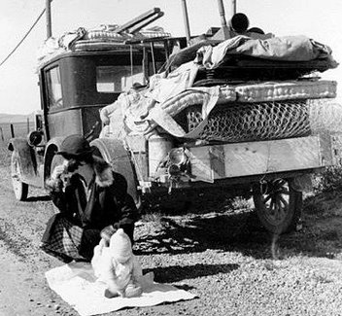
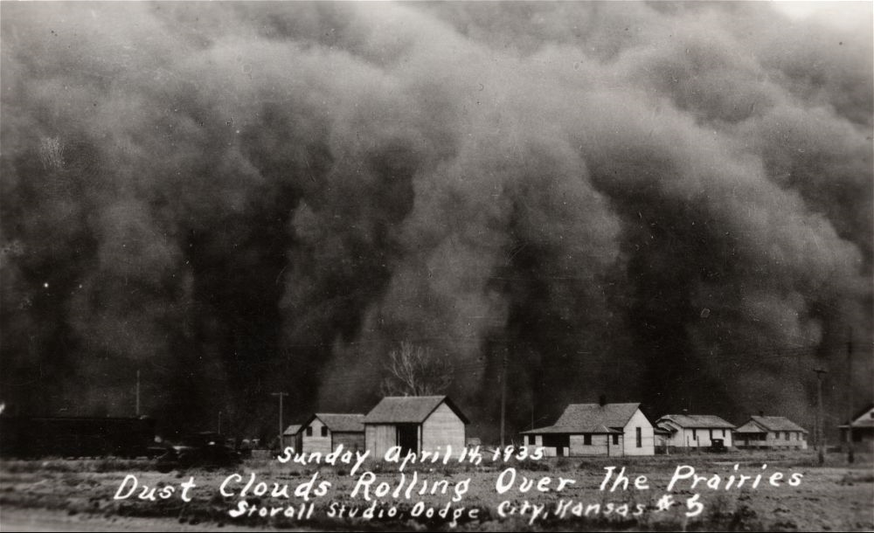
The Dust Bowl
Drought in , dust storms in 1932
People’s farms were literally blown away in the Dust Bowl
Families hoped to find work in California

Slide 12
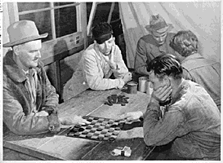
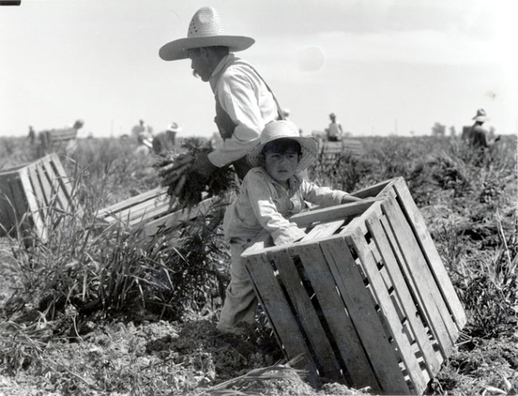
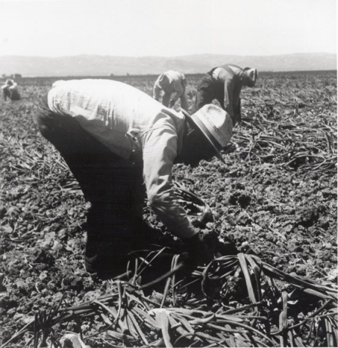
Migrant Workers
___________________moved to follow the crops
Work of 350 men could now be done by 5
Workers would earn $2.50-$3/day + food and basic accommodations
Too many migrants in California led to families being turned away at the borders, and a decrease in wage. Many workers couldn’t support their families.

Slide 13
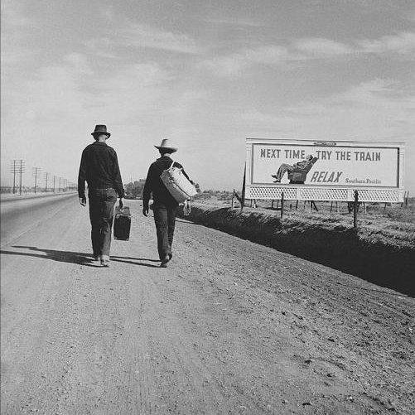

Slide 14
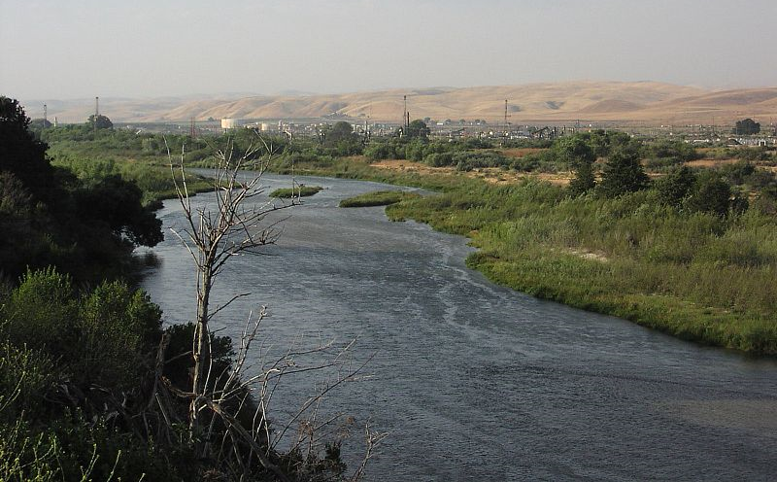
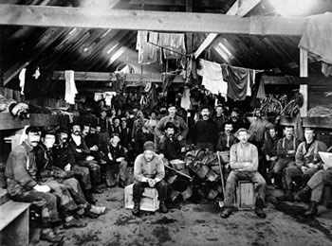
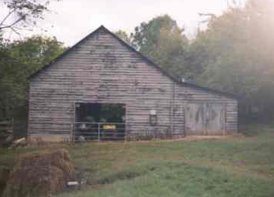
Setting – California
Soledad, CA
Soledad means solitude
or loneliness
3 specific settings
Along the banks of the
Salinas River
In the ranch bunk house
In the

Slide 16
The American Dream!
Dreams for a
Reasons:
Escape from persecution or poverty
To make a new life for themselves or their families
$$$$$$$$ & Gold

Slide 17
Disabled
People were __________ against based on the color of their skin
How much more would people be discriminated against for their legitimate handicaps?
In the 1930s, people were just starting to raise awareness about disabilities.

Slide 18
Themes of the Novel
Friendship
Loneliness
_______________of the world
Worth of an individual

Slide 19
Lennie and George
Lennie has a mental disability
George is his caregiver, of sorts
It’s important to understand that Lennie has a disability in order understand George’s motivations for his actions.

